Slide 1


Agile at ON.Lab
Bill Snow
VP of Engineering

Slide 2

What is waterfall?
Requirements
Design
Develop
Test
Or
Requirements
Design
Develop
Test
Time

Slide 3
Assertion
We cannot precisely anticipate
  Our users’ requirements
  How long it takes to develop a feature or system
  Which design will be best
  What tasks are needed to develop a feature

Slide 4
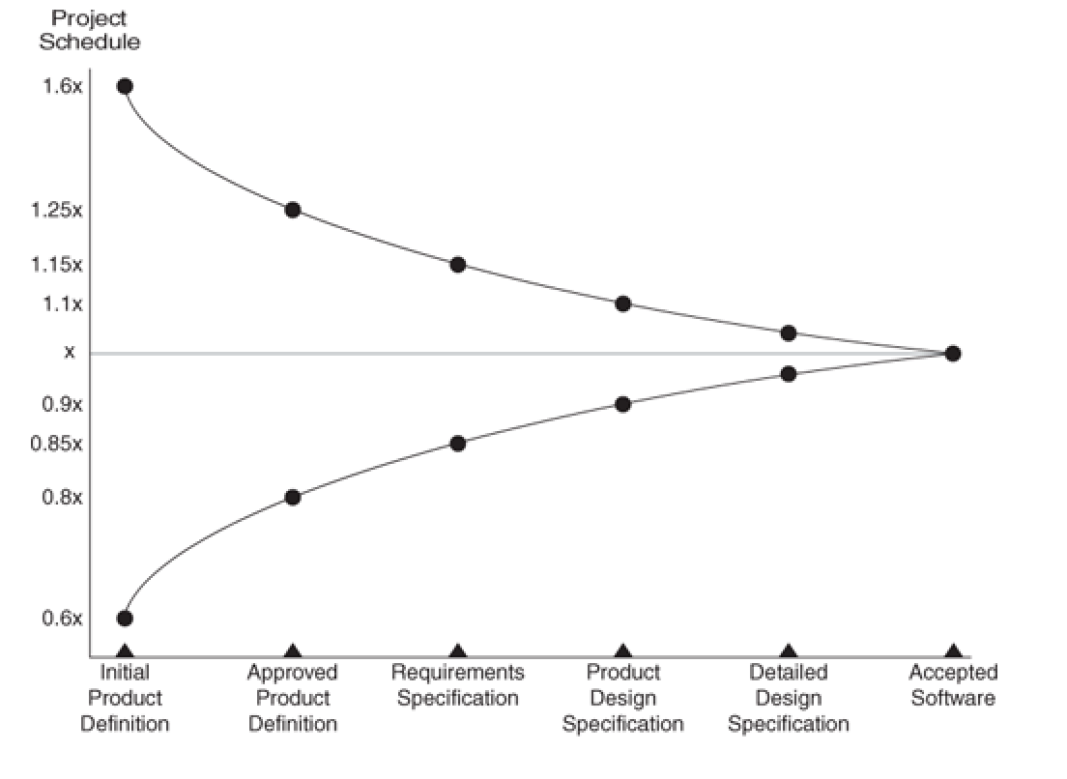
The cone of uncertainty
16 weeks
10 weeks
6 weeks
From the book Agile Estimating and Planning by Mike Cohn

Slide 5
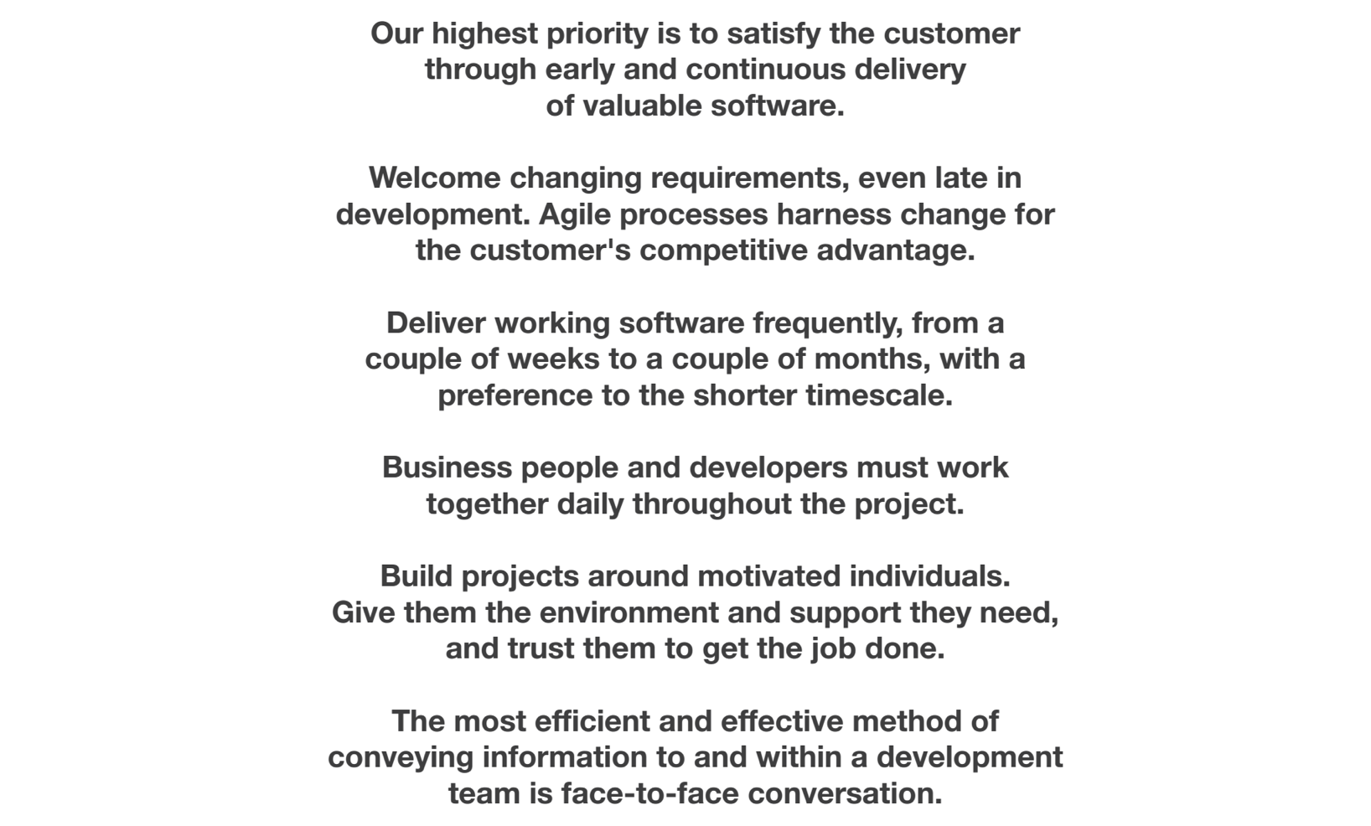
Principles behind Agile

Slide 6
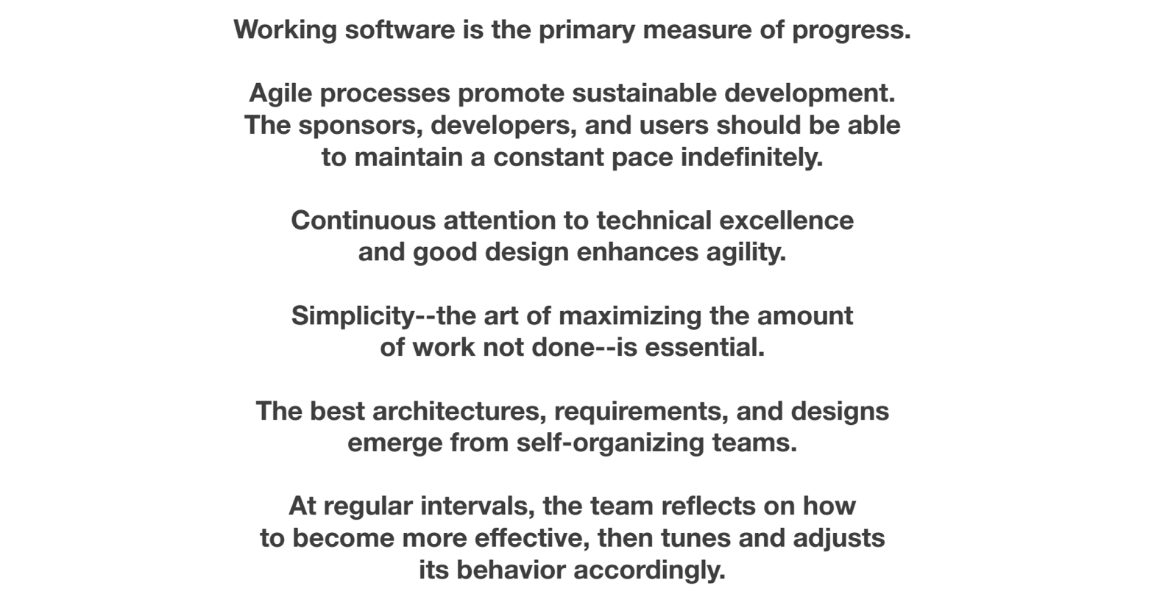
Principles behind Agile

Slide 7
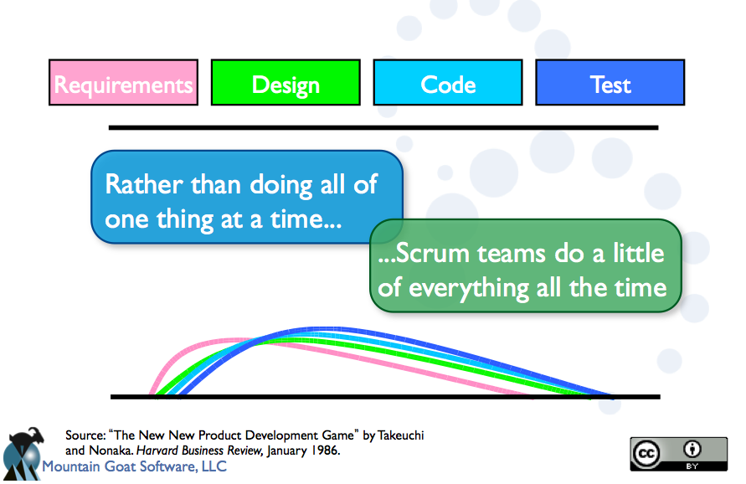

Slide 8
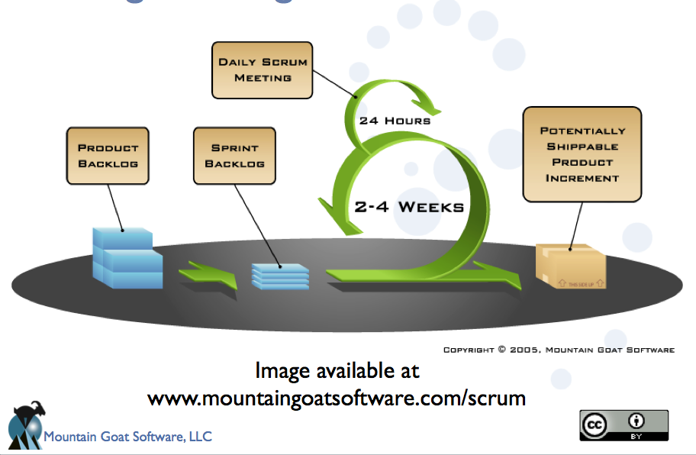

Slide 9
Differences
Team is cross functional – artifacts are not handed off between functional groups
Team works in short iterations of 2-4 weeks – not in long periods of months or years.
Working code is delivered every iteration. Not just at the end.
Planning is done every iteration, not just at the beginning.
Requirements change over time and are not set in stone at the beginning.
Customers are continually involved in the cycle, not just in beta and the end.
Less documentation
More “shoot first, aim later”
Less pretense of long term foresight

Slide 10
Real World Example
DC 1
CLI
DC n
CLI
Service Provider’s Portal
Application
Layer
GUI
Calendaring Application
ONOS
User
Space
Path Computation Engine (PCE)
Optical
Topology
DB
+ “Regen Locations”
Optical Reach
Matrix
BW, Distance
ONOS Service Layer
ONOS Packet & Transport Graph
ONOS
Kernel
Topology
&
Planning
Constraints
Instance 1
Instance 2
Instance 3
OpenFlow
Manager
OpenFlow
Manager
OpenFlow
Manager
Forwarding Plane
3
Building Block for Iteration 1

Slide 11
Release Model
Quarterly
“train” Releases
2-3 Week
Iterations
Nov Release
Iteration 1
Plan
Iteration 2
Feb Release
Iteration Planning
Execution
“Demo”
Plan
Iteration 3
Iteration 4
May Release
Plan
Iteration 5
Aug Release

Slide 12
Release and Iteration Planning
“Backlog”
Features
Prioritized
Content
Technical Debt
Architecture
Use cases
…
Performance
Bugs
Jira
Database and Workflow

Slide 13
Tracking Release Content
Jira – issues tracking, workflow
Hierarchy of Jira issues
  Epic – work happening throughout a release
    Stories – work that fits in a sprint
      Tasks – work that is done in 1-2 days
See wiki for more details

Slide 14
Summary
ON.Lab uses a version of Agile Scrum
  3 month releases, 3 week iterations
People unfamiliar with agile, will find it different (and initially uncomfortable)
We all work together to learn and improve
Watch this 10 minute video
  https://www.youtube.com/user/axosoft?v=XU0llRltyFM

