Slide 1
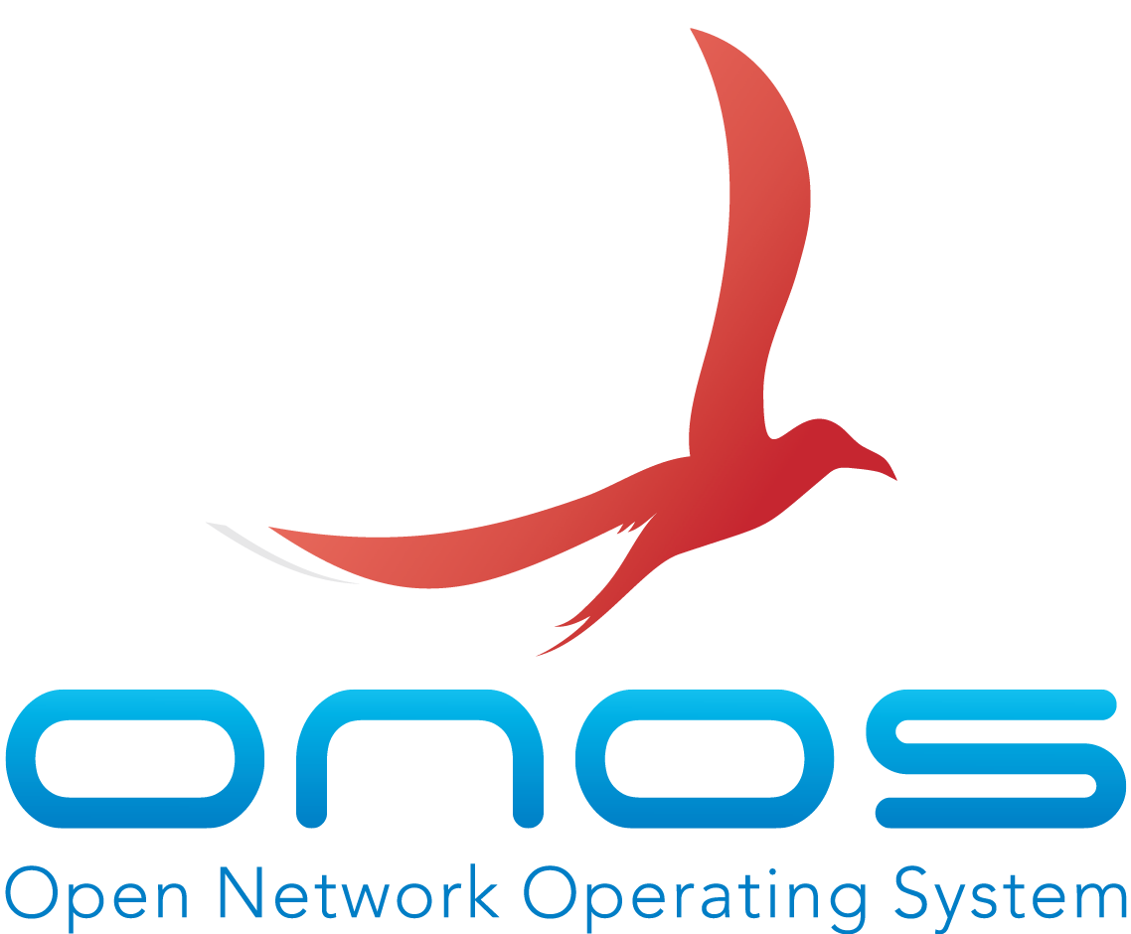
Multi-layer Network Control with ONOS

Slide 2
P3
P5
Logical Tunnels
P1
P2
P4
P3
P5
P1
Primary
IP Layer
P4
P2
Backup
O4
O7
O2
O1
Optical
Light Paths
O3
O5
O6

Slide 3
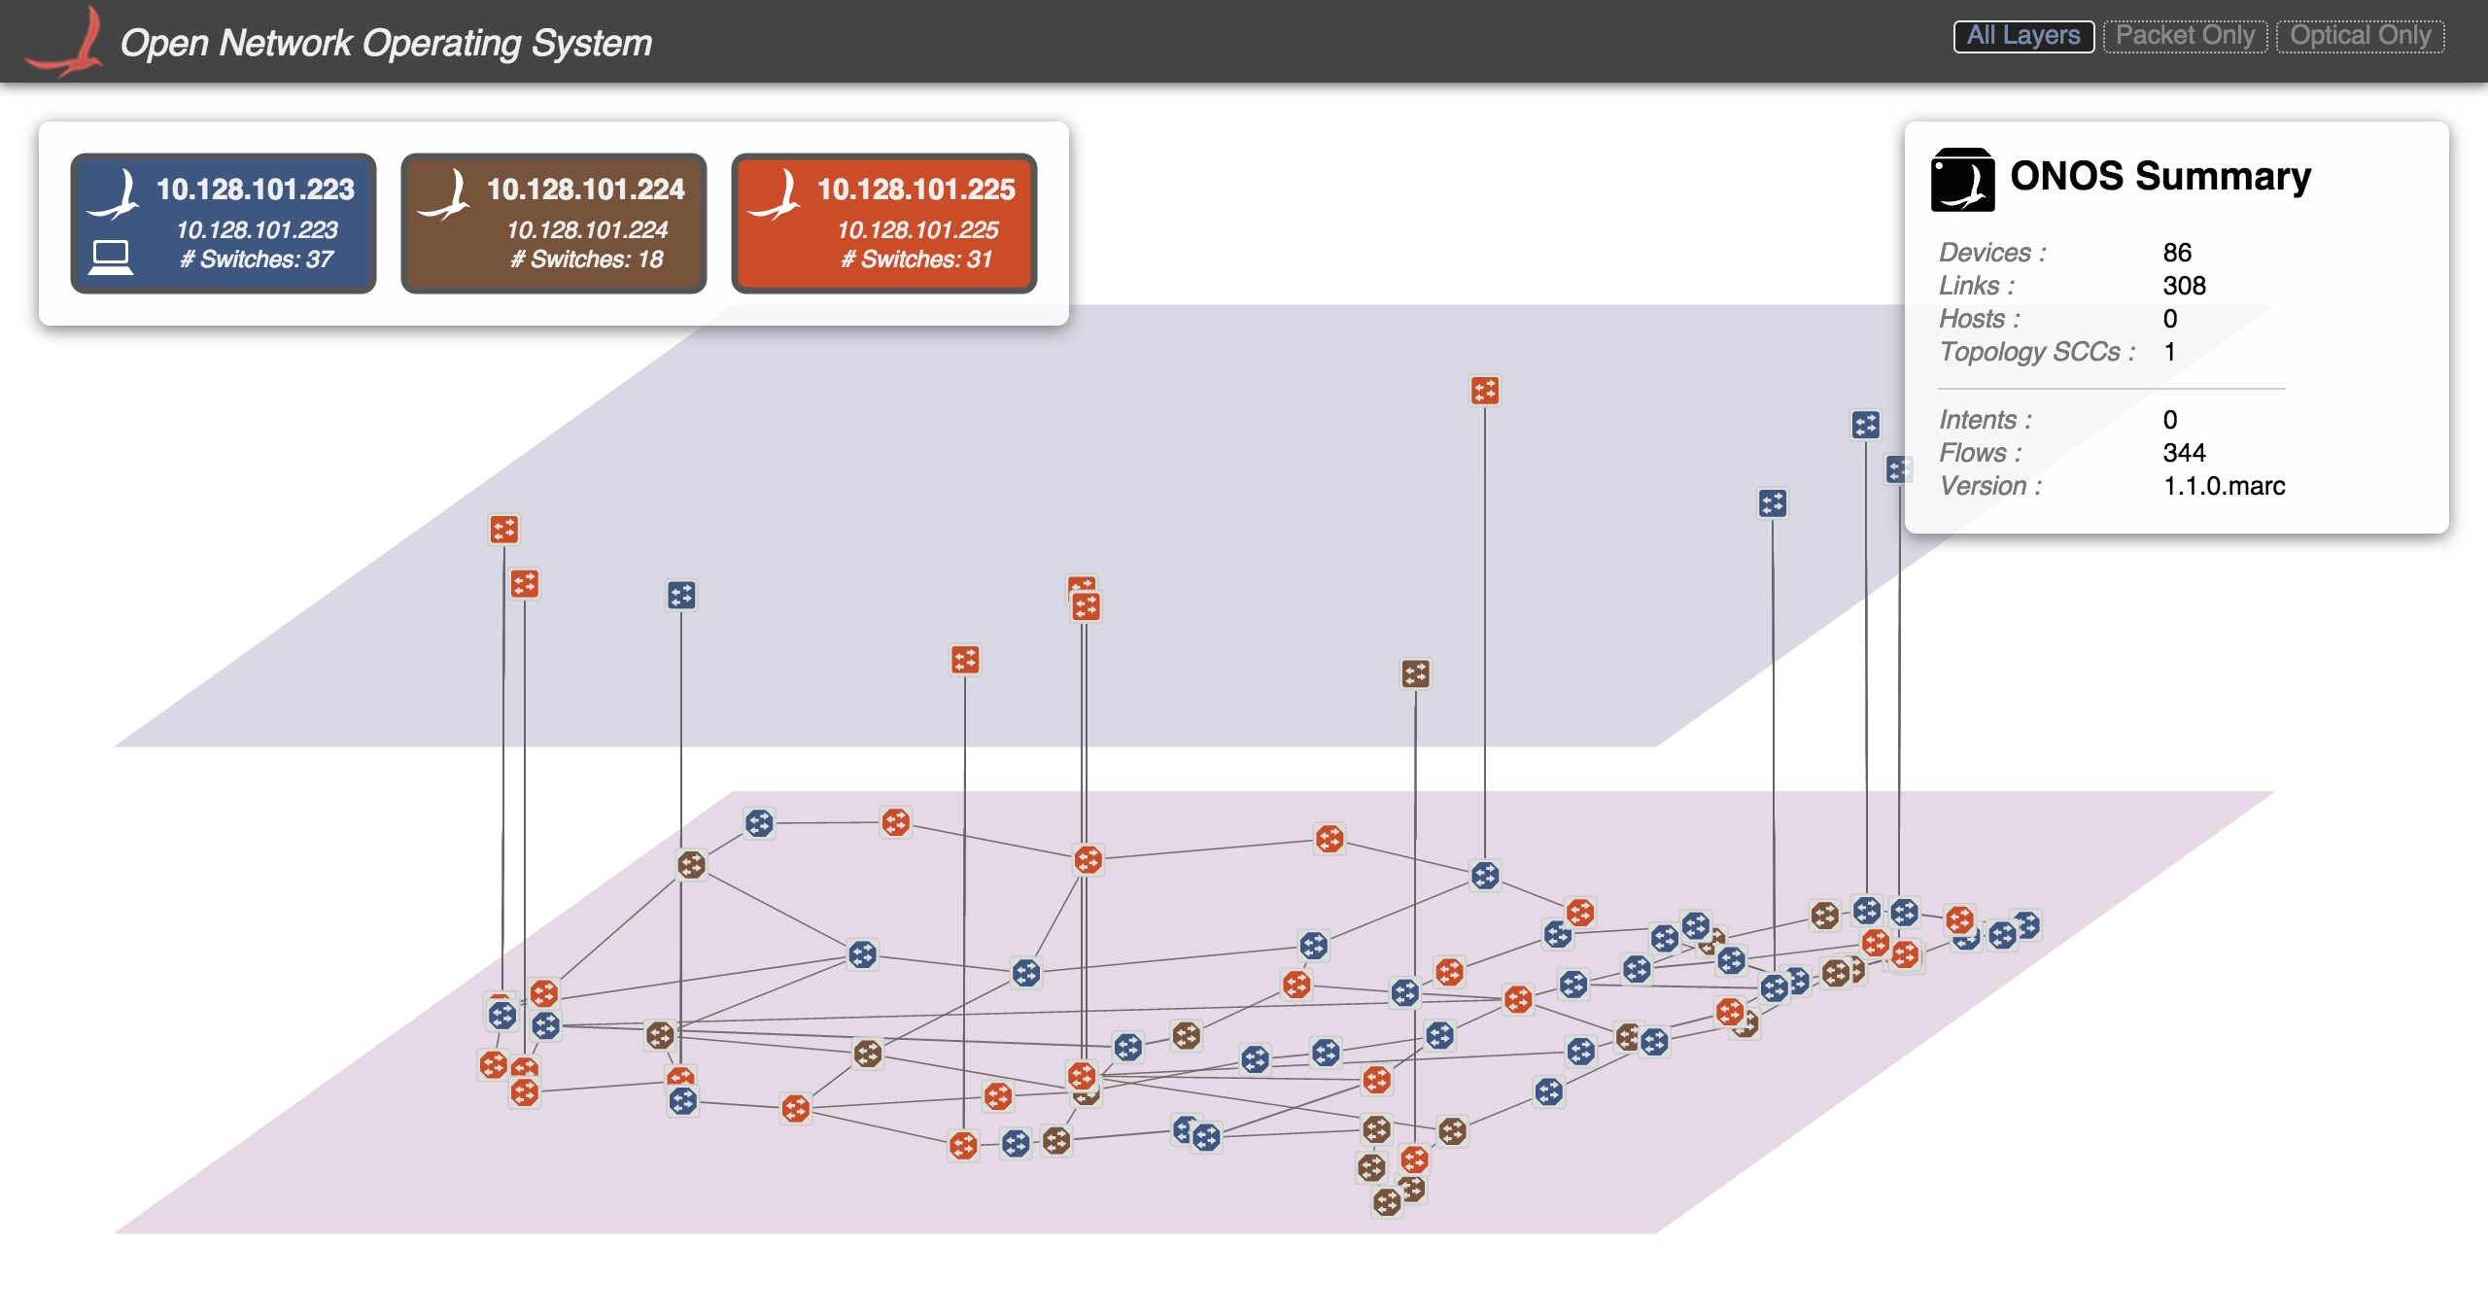

Slide 4






On-Demand
Optical Bandwidth
Advanced Multi-Layer Restoration
Multi-Layer Network Optimization
ONOS
Menlo Park, CA
OF provider
Ciena TL1 provider
Fujitsu TL1 provider
Huawei PCEP provider
IP Layer
Optical layer
Ottawa, Ontario
Richardson, TX
Plano, TX
Domain A
Domain B
Domain C

Slide 5
Key values demonstrated
Demonstration with real hardware at both packet & optical layers
Single control plane supports multi-vendor, multi-protocol network
Any application can apply policies for multiple layers
based on resource availability, economics and policies

Slide 6
Thank you

