Slide 1

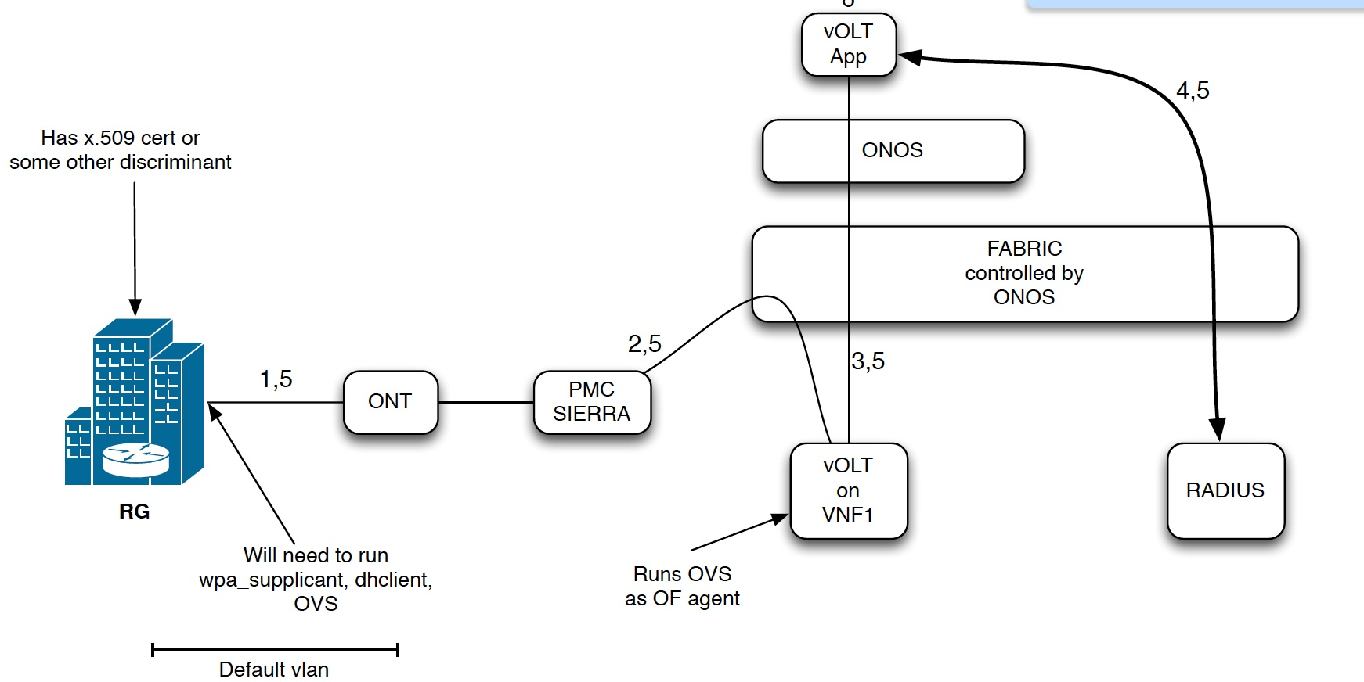
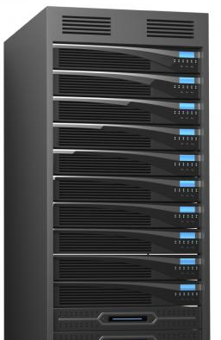
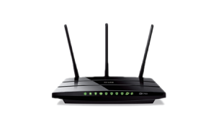
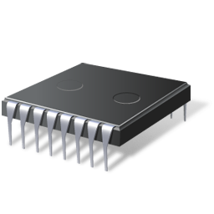

Demo Set-up Part 1 ( does not include NFaaS)
6
5
1
8
2
3
7
OpenWRT (Residential Gateway)
4
Chip
Server
Device
Software

